Slide 1
Creating your Innovation Agenda within Digital Explorer
Agendas Release 1.0.5

Slide 2
Contents
Overview
Innovation Agenda module output
Definition of terms
Agenda metamodel
Creating your agenda
Viewing your agenda
Creating strategic programs
Horizon diagram and value chain views
Agenda Insights
Supporting template

Slide 3
Refining our knowledge to Client Strategic Initiatives
Review the Business Trends within Digital Explorer
Review the technology trends within Digital Explorer
Business Trends
Technology Trends
Define the value chains for your client
Map the relevant disruptors into each value chain
Identify the focus area disruptors
Value Chain
Value Chain
Value Chain
Group focus areas into strategic initiatives
Client Strategic Initiative
Client Strategic Initiative
Client Strategic Initiative

Slide 4
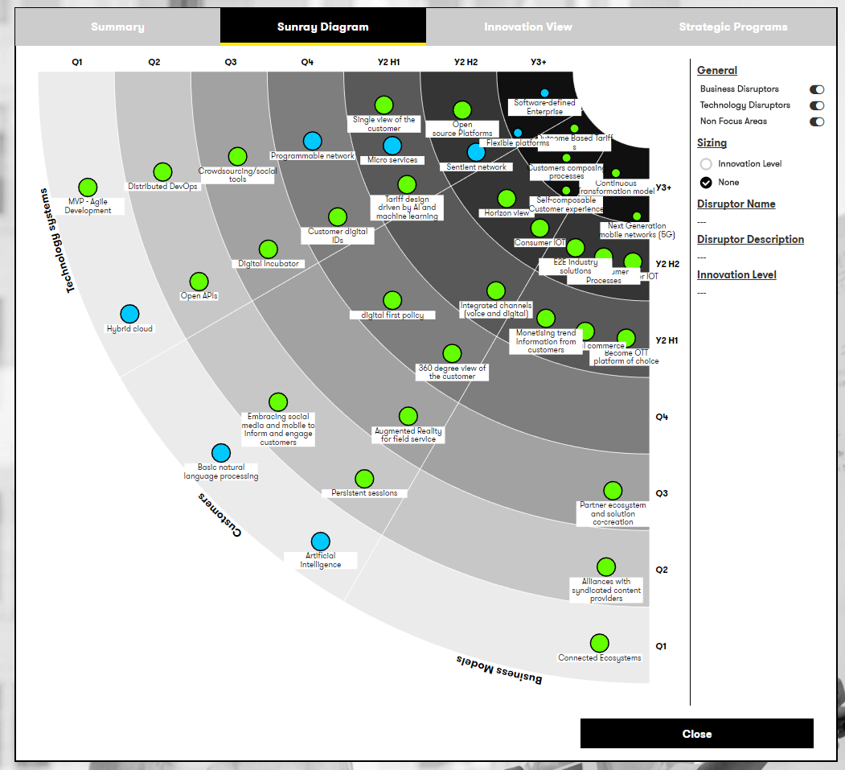
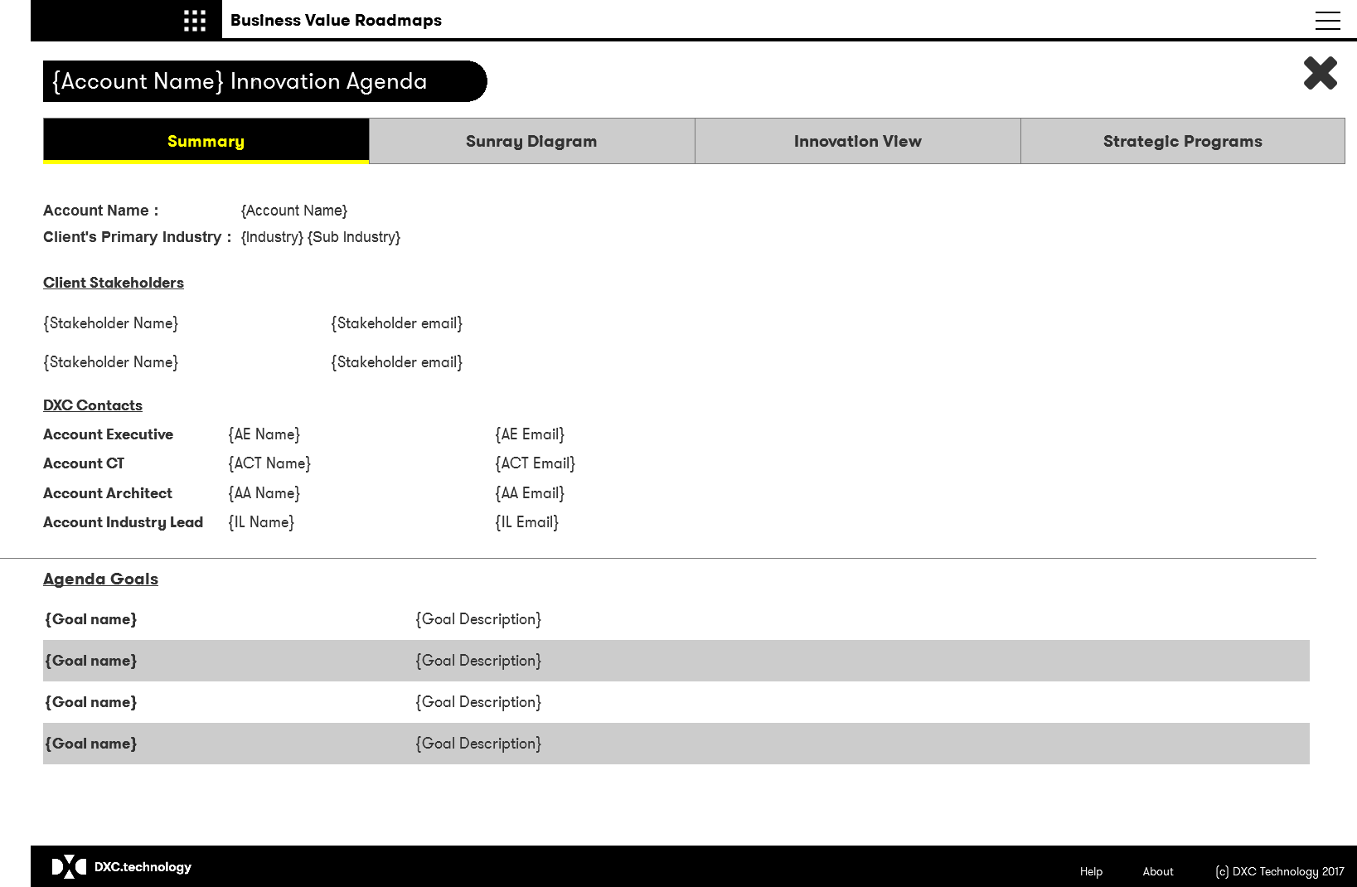
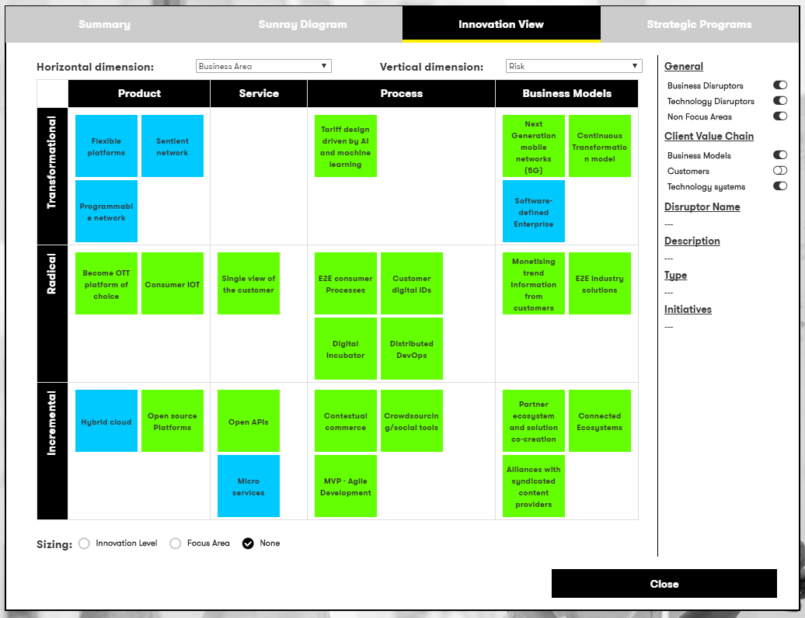
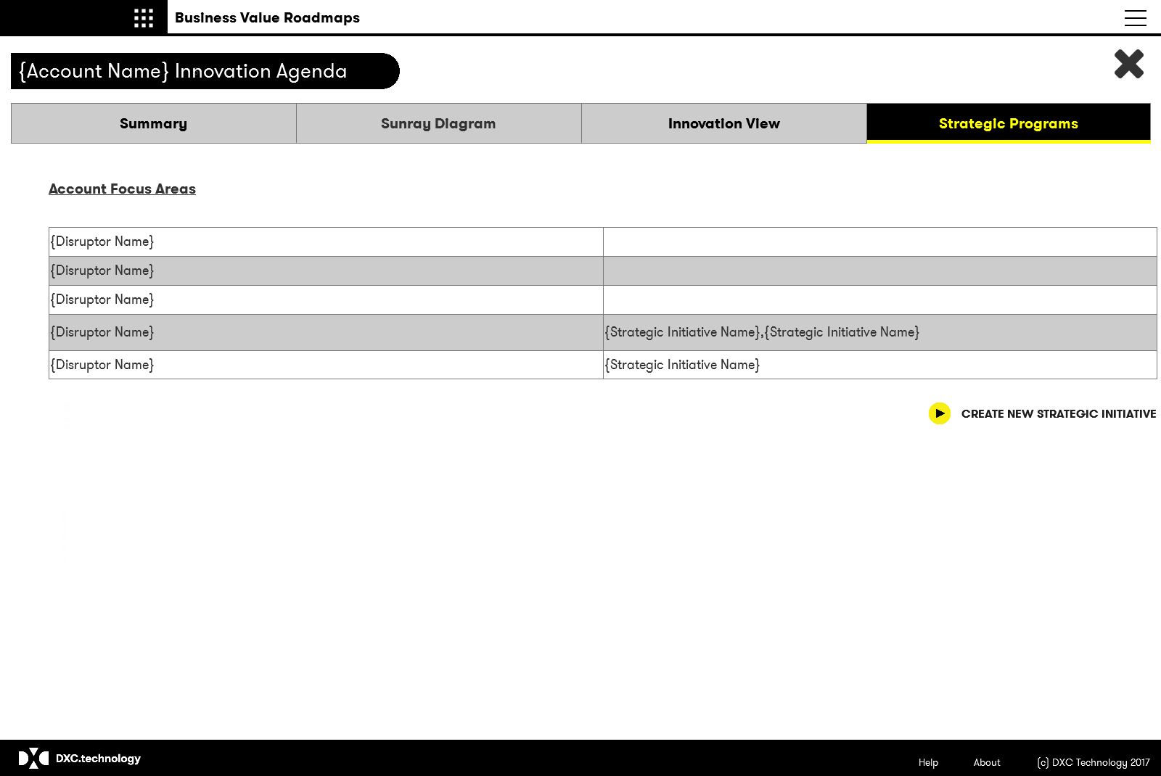
Business Value Roadmaps - Output
Summary
Sunray Diagram
General information related to the client and the innovation agenda
Sunray via of all client value chains, reaching towards the agenda goals
Innovation Risk Table
Strategic Programs
Dynamic table to present the business area and innovation levels for each client disruptor
Create and view details of identified client strategic programs identified through the innovation agenda

Slide 5
Innovation Agenda model
Client Innovation level
I
R
T
Related business area
Pd
S
Ps
B
Client Innovation Agenda
Goal
Goal
Goal
Goal
Client Value Chain
Client Value Chain
Business Disruptors
Technology Trends
Signal
Business Disruptors
Technology Trends
Signal
I
R
T
I
R
T
I
R
T
I
R
T
I
R
T
I
R
T
Pd
S
Ps
B
Pd
S
Ps
B
Pd
S
Ps
B
Pd
S
Ps
B
Pd
S
Ps
B
Pd
S
Ps
B
Strategic Initiative
Strategic Initiative
See next slide for definition of terms

Slide 6
Definition of terms
Term | Description
Agenda Name | Friendly name of the innovation agenda
Agenda Description | Detailed description of the innovation agenda
Agenda Goal | Represents a high-level statement of intent, direction, or desired end state for the agenda
Client Value Chain | A value chain is a process or activity within an industry, which provides direct internal or external benefit or revenue. (examples : Business Models, Aftermarket care, Customer Experience, Design).
Client Value Chain Business Area | A mapping to the relevant business area for the value chain as defined within the overall industry innovation model.
Client Value Chain KPI | A known Key Performance Indicator for the client's value chain.
Client Value Chain Stakeholder | Name of any known stakeholders for the define client value chain
Agenda Stakeholder | Name of any known stakeholders for the overall innovation agenda
Disruptor | Short name of the disruptor - default is the value from Digital Explorer, but can be overwritten to reflect the clients terminology
Disruptor Description | Detailed description of the disruptor - default is the value from Digital Explorer, but can be overwritten to reflect the clients terminology
Signal
Disruptor innovation level: Incremental | Addressing this disruptor has incremental impact and benefit for the customers’ business (e.g Evolutionary roadmap item improves effectiveness or efficiency of a product, service process or business model) Evolutionary roadmap item
Disruptor innovation level: Radical | Addressing this disruptor has a radical impact and benefit to the customers’ business (e.g brings customer up to top quartile performance in the area in terms of product, service process or business model)
Disruptor innovation level: Transformational | Addressing this disruptor has Transformational impact on the customers’ business, (e,g clear blue water between customer and followers in terms of product, service process or business model)
Disruptor Business Area: Product
Disruptor Business Area: Service
Disruptor Business Area: Process
Disruptor Business Area: Business Model
Focus Area | Flag to highlight if a disruptor is a focus area for the account team
Client Strategic Initiative | A committed account initiative based on the output of the innovation agenda, can address one or more focus disruptors.

Slide 7
Approach
Understand Client and Industry direction
Create the initial agenda
Refine/discuss agenda with account team and client
BVF
Business and Technology Trends
Client Value Chains
Stakeholders
Key trends
Innovation levels
Focus areas
Outline account plan
Strategic initiatives

Slide 8
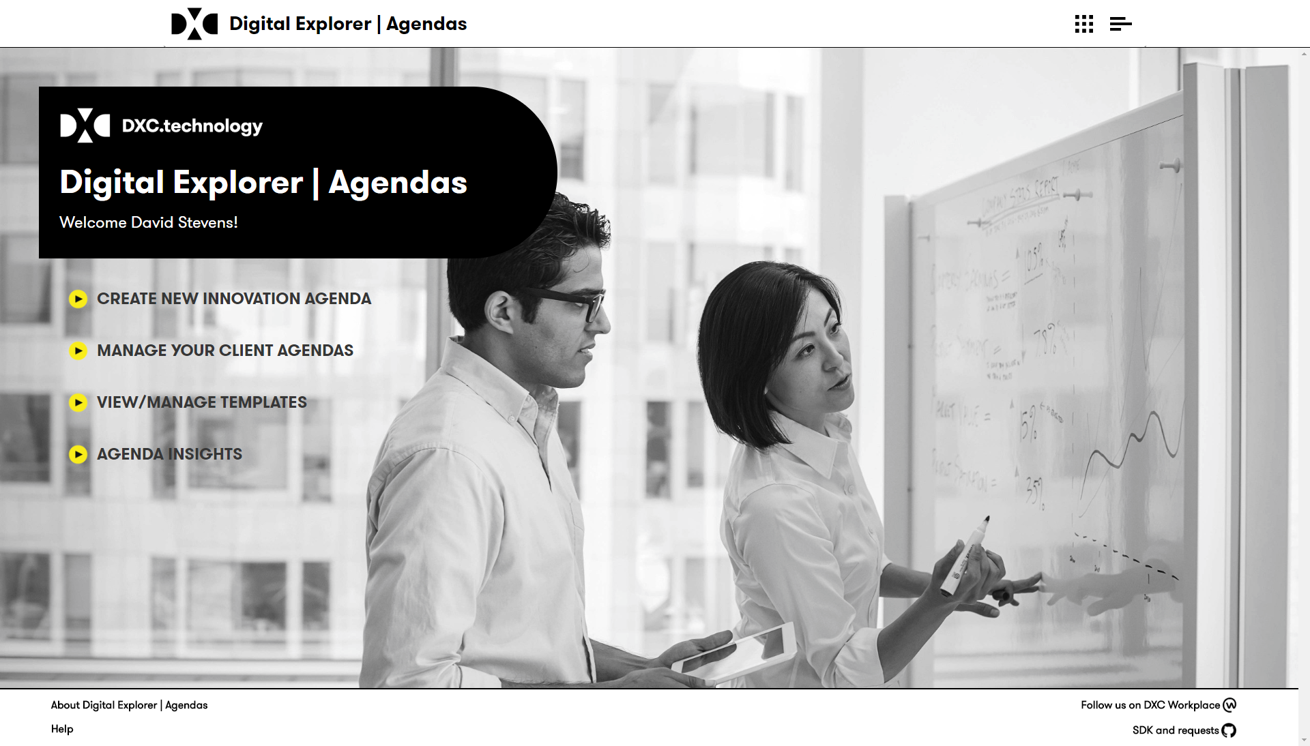
Innovation Agenda landing page
Once logged in you can
Create a new innovation agenda
Manage your existing agenda
View trend insights across all agendas

Slide 9
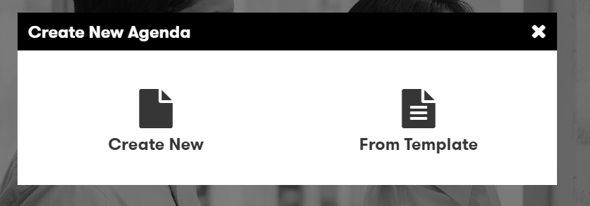
Innovation Agenda 1/5
Select to create either a new (blank) agenda or start from an agenda template

Slide 10
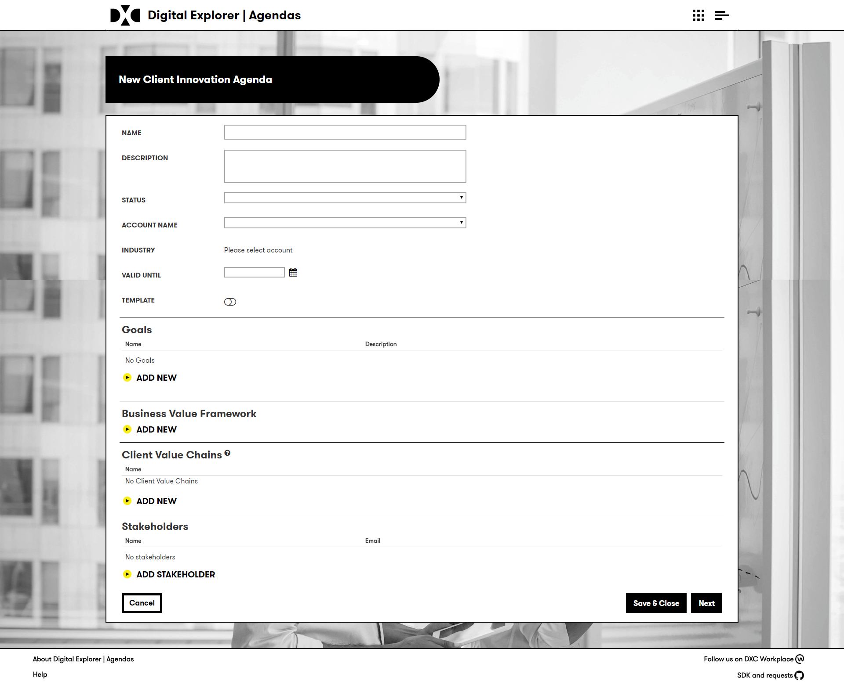
Innovation Agenda 2/5
Select “Create new agenda” from the homepage
Enter the name and description
Select from the list of available account
if your account is not listed, contact the support team
You can also select “training account” to create a test agenda
Select a “valid until” date
Add the goals related to the agenda – these should be taken from the account BVF.
You can add the BVF as an image
Client Value Chains – The module will automatically create the industry value chains (as defined within DE)
Add the details of any key stakeholders

Slide 11
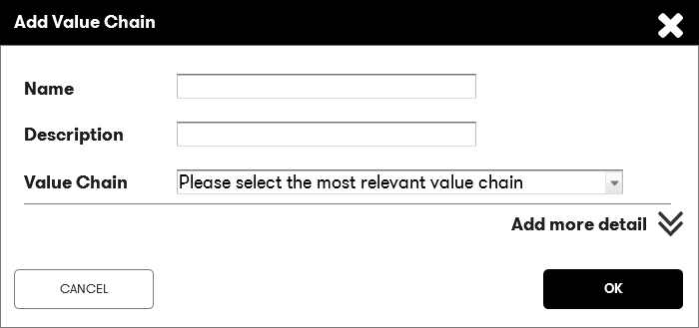
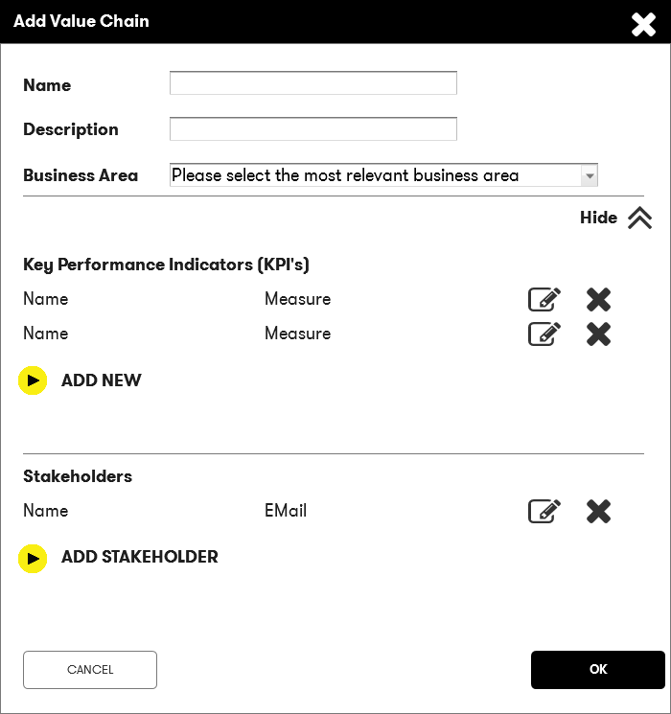
Innovation Agenda 3/5
Waiting for updated UI
The tool will automatically create the industry value chains as defined within Digital Explorer for your clients industry.
You can delete or add new value chains as required.
Enter the name and description of the client value chain
Select an appropriate business area for the initiative
Expand the dialog to add any additional information:
Enter any known KPI’s for this value chain
Add any key stakeholders
You can also add these via the canvas

Slide 12
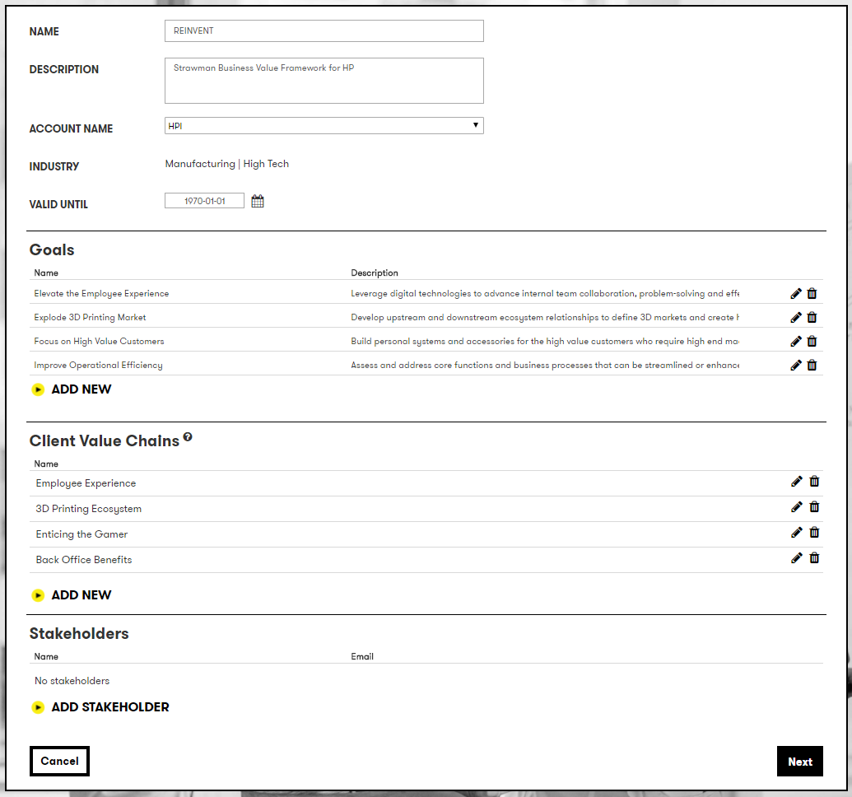
Innovation Agenda 4/5
Once you have completed the initial set of information click “next”

Slide 13
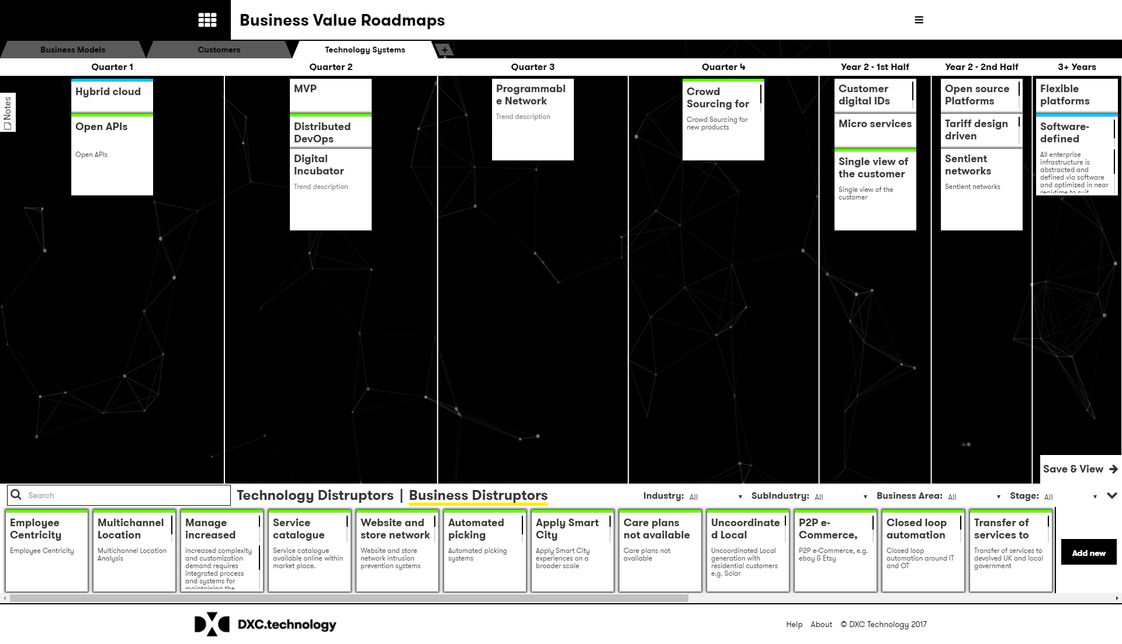
Innovation Agenda 5/5
The canvas is initially populated with any Value Chains defined on the initial page, each Value Chain is presented via it’s own tab.
If you selected a template, some initial trends may also be included.
The following slides detail how to work within the canvas.

Slide 14
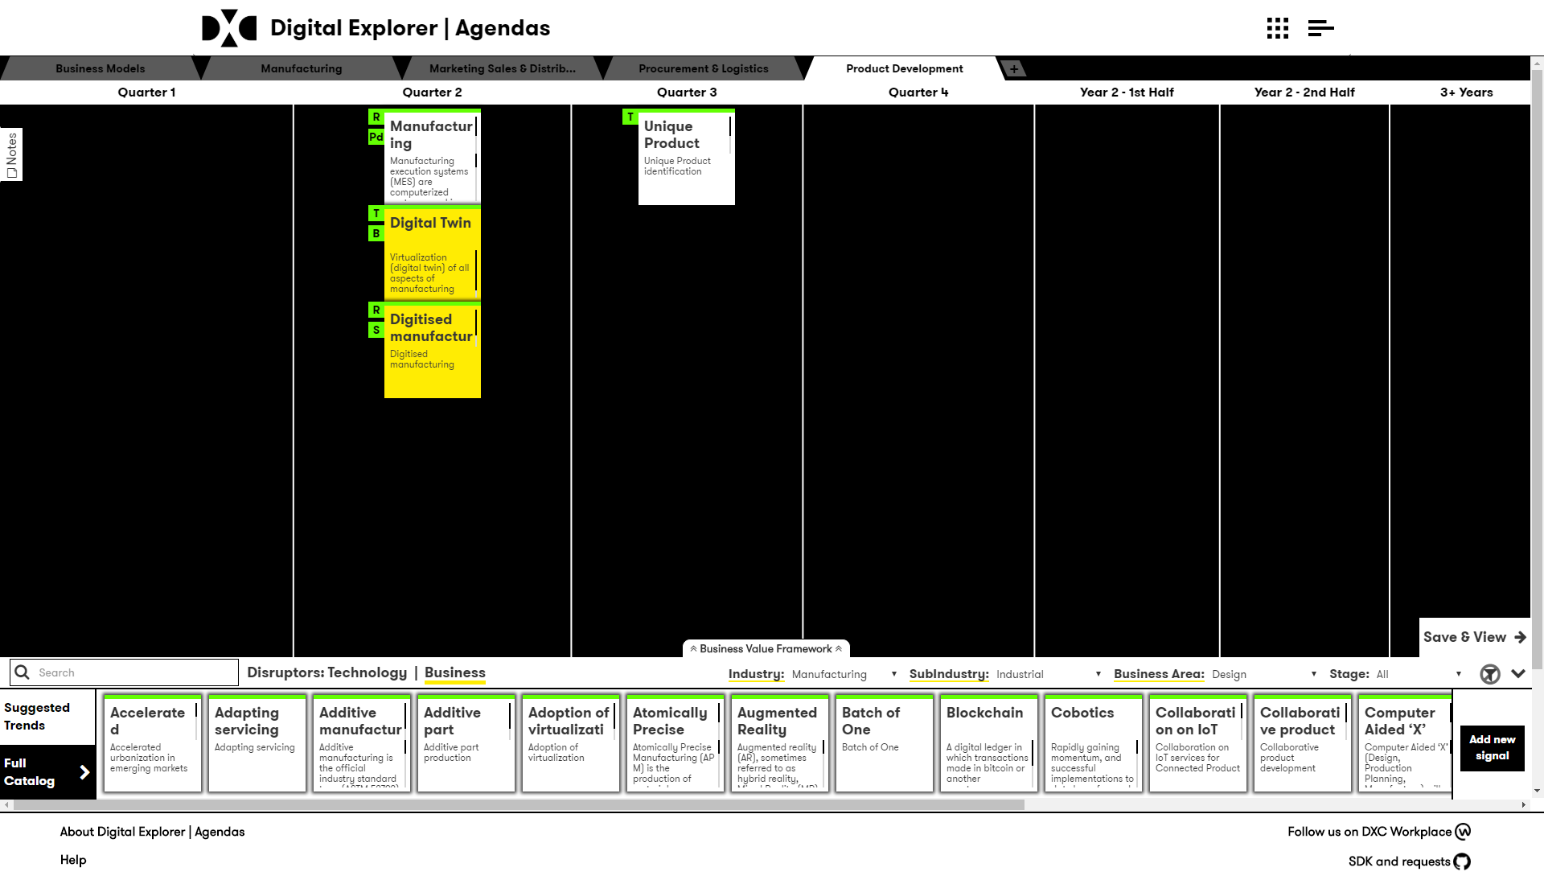
Working in the Canvas
Add new value chain
Time frame
Add Notes related to this chain value
View or add your BVF
Save & View your agenda
The
disruptor
dock

Slide 15
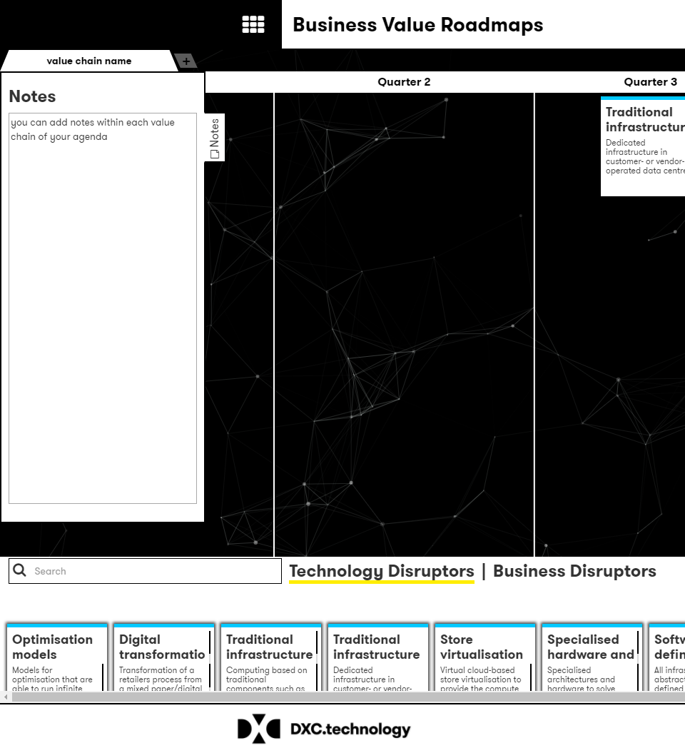
Notes
Notes can be added to each Value Chain within the agenda.
Click on the notes tab to expand into view.

Slide 16
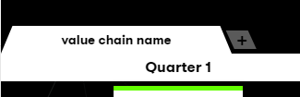
New Value Chain
To add a new Value Chain, click on the “+” tab
The information required is the same as on the initial agenda creation screen.

Slide 17
The disruptor dock
Waiting for updated UI
You can filter and search for disruptors relevant to the client value chain
Industry disruptors can be filtered based on industry, sub industry, business area and lifecycle stage.
Technology trends can be filtered based on the technology group and lifecycle stage.
Use the “Suggested Trends” to help with recommendations
If you don’t find a matching disruptor, you can add a new “Signal” to your client agenda.

Slide 18
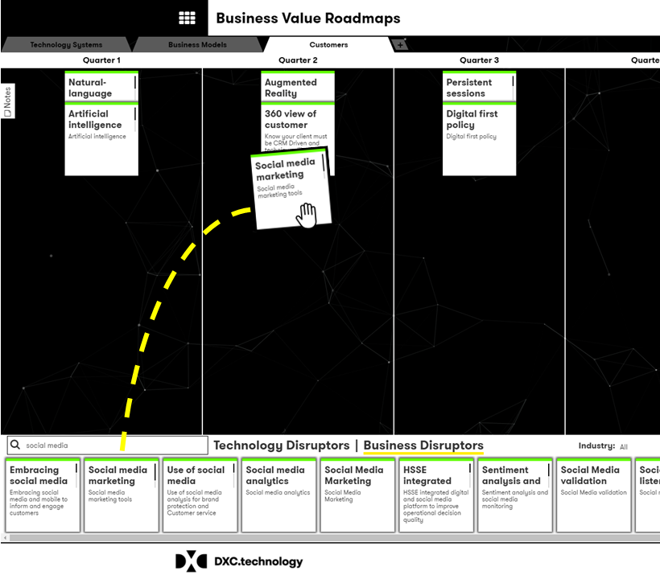
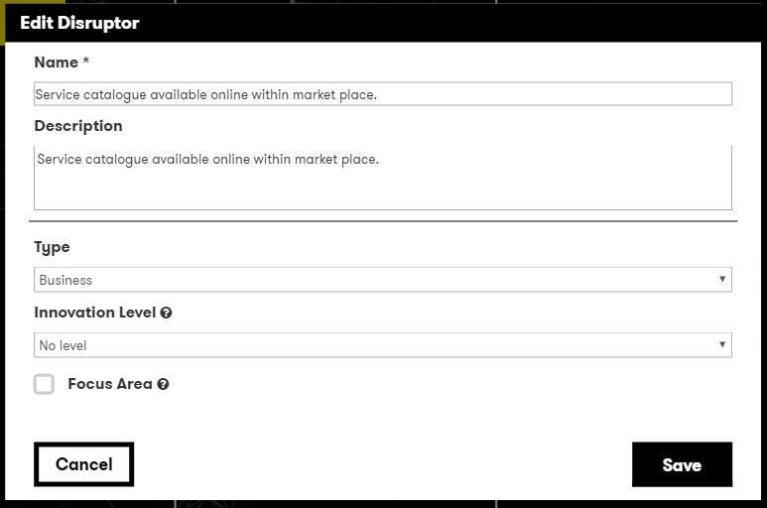
Positioning and editing disruptors
To place a disruptor within the required time segment of the value chain, simply drag and drop the disruptor into place.
Once a disruptor is positioned; double clicking will allow you to edit the disruptor where you can
Change/update the name or description
Define the innovation level this trend has for a client
Call out if this is a focus area
You can move a disruptor to another time segment or remove it by dragging and dropping it back into the dock area.

Slide 19
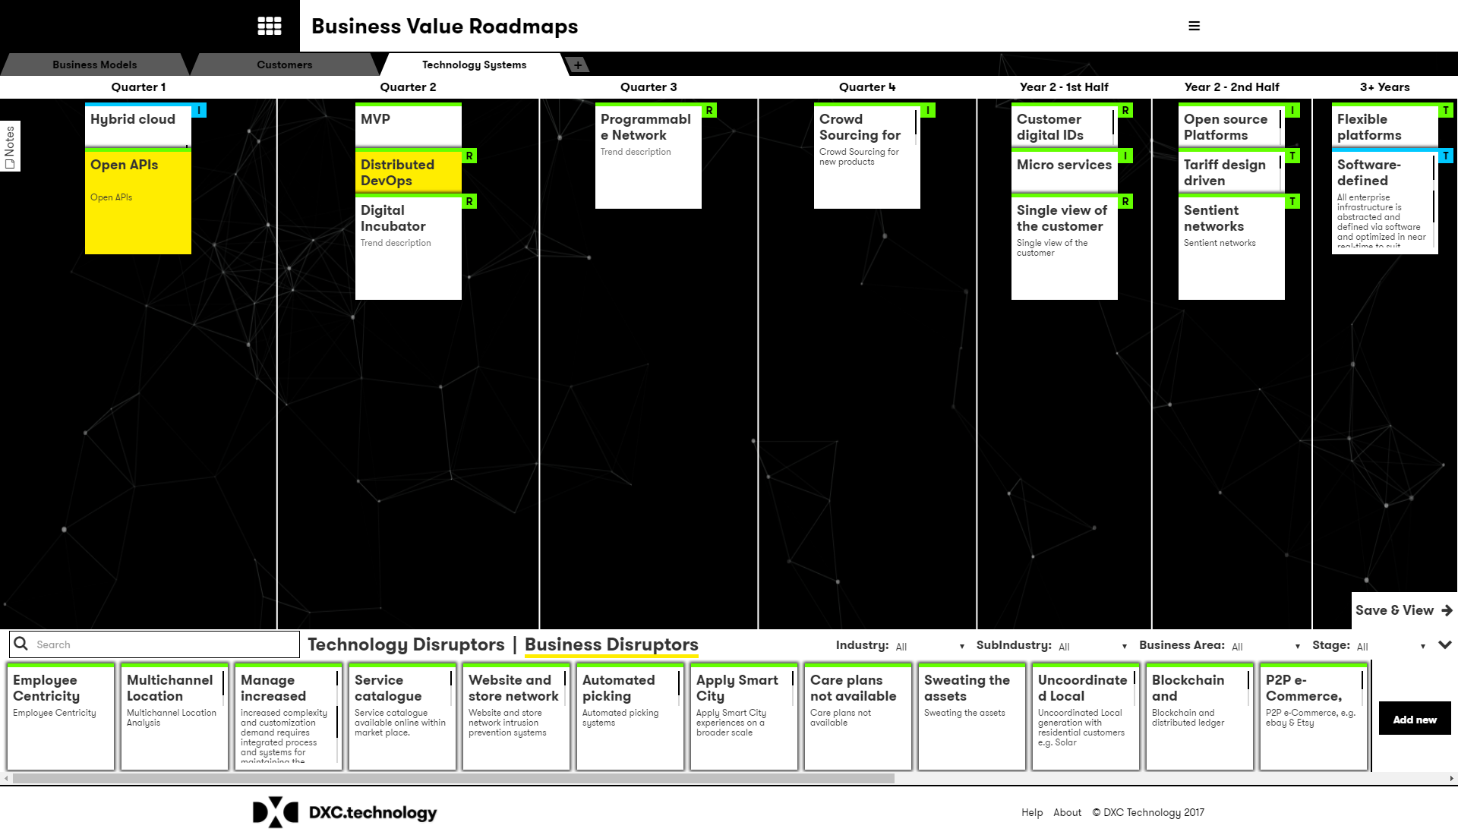
Disruptor Innovation levels and Business Areas
Extend the level of information for each client disruptor by double clicking and defining the innovation level* and associated business area* for each disruptor
As you add these values, a clear marker is shown within the canvas view
* See the definition of terms the descriptions of each value within these properties

Slide 20
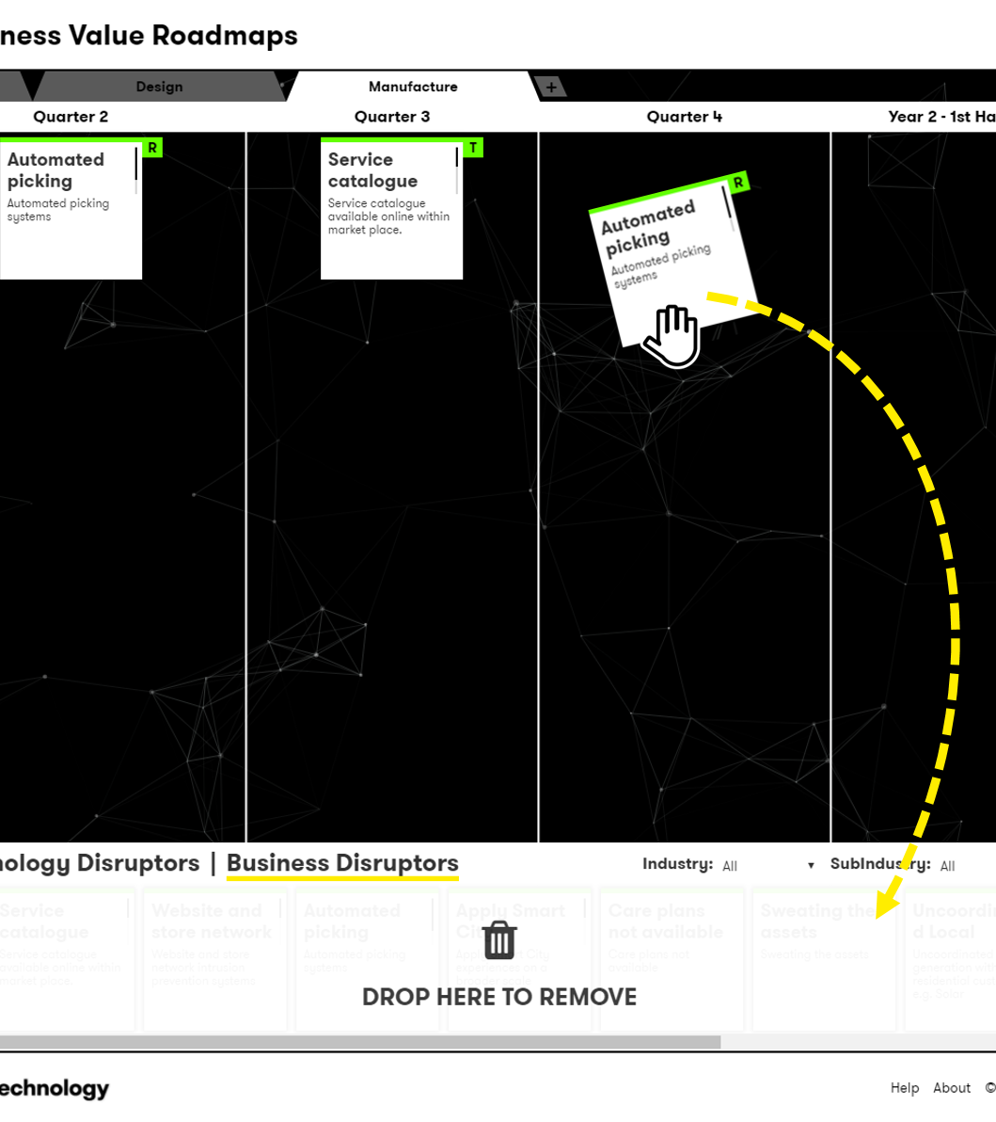
Removing Disruptors
To remove a disruptor from the agenda, drag and drop it back into the dock at the bottom of the canvas.

Slide 21
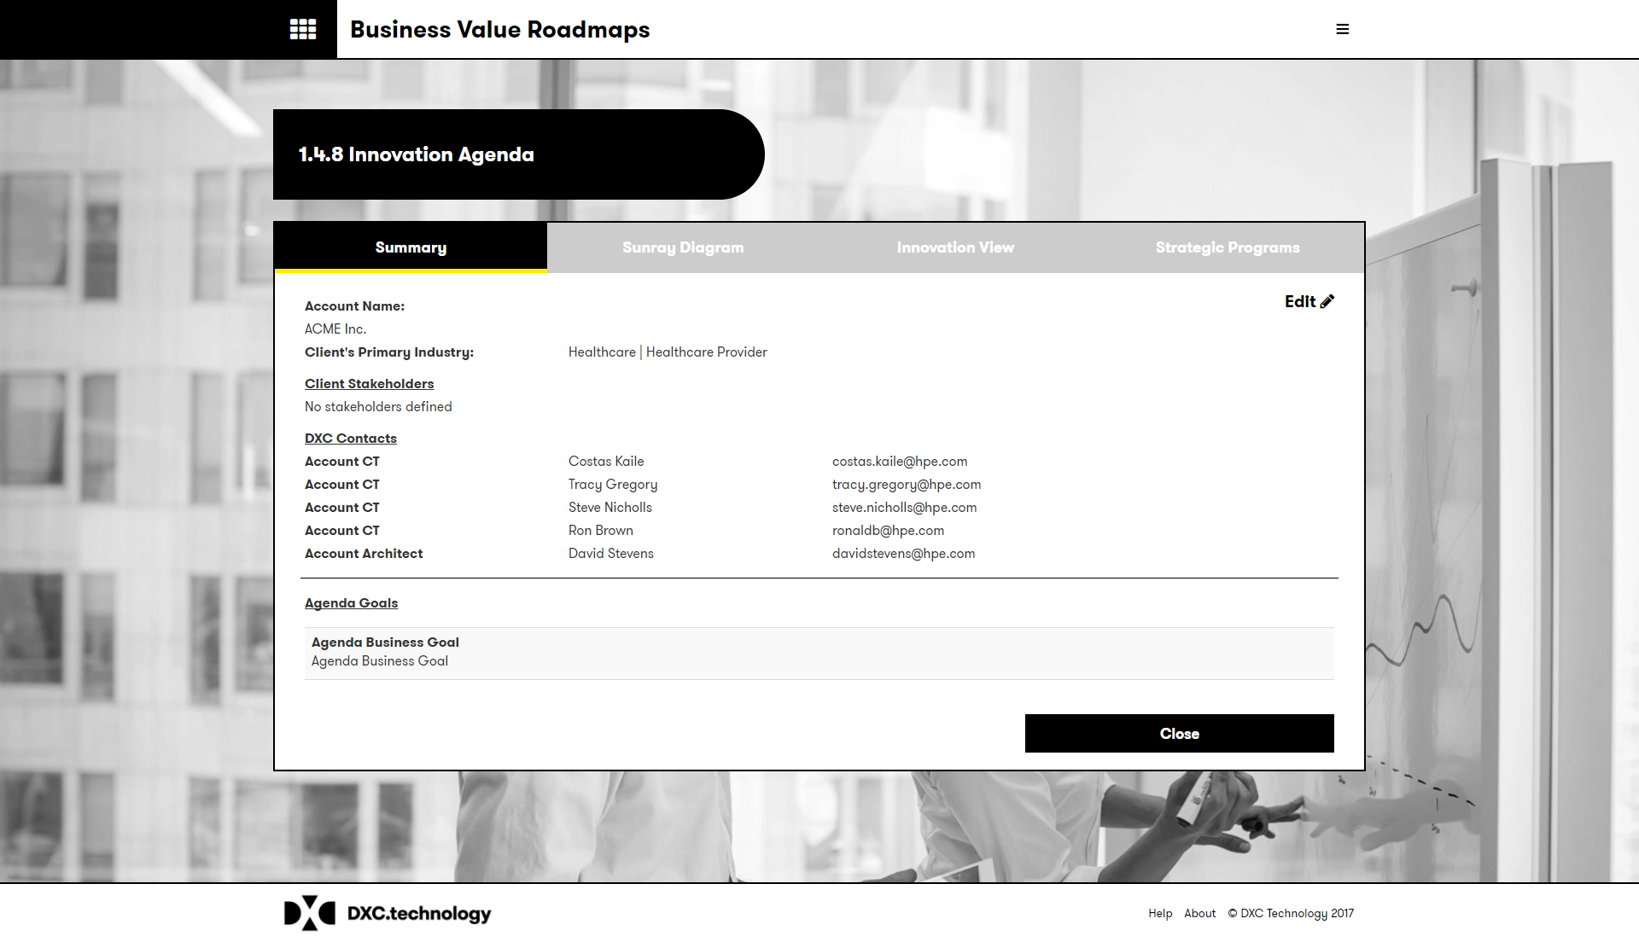
Viewing your agenda
Once your agenda is saved you are presented with the agenda document.
You can also access the agenda via the homepage and the “manage your agenda” option.
Within the Agenda view you can:
View the sunray diagram
View the innovation summary
View and create the strategic initiatives

Slide 22
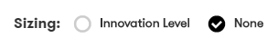
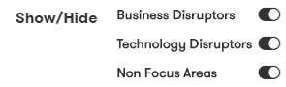
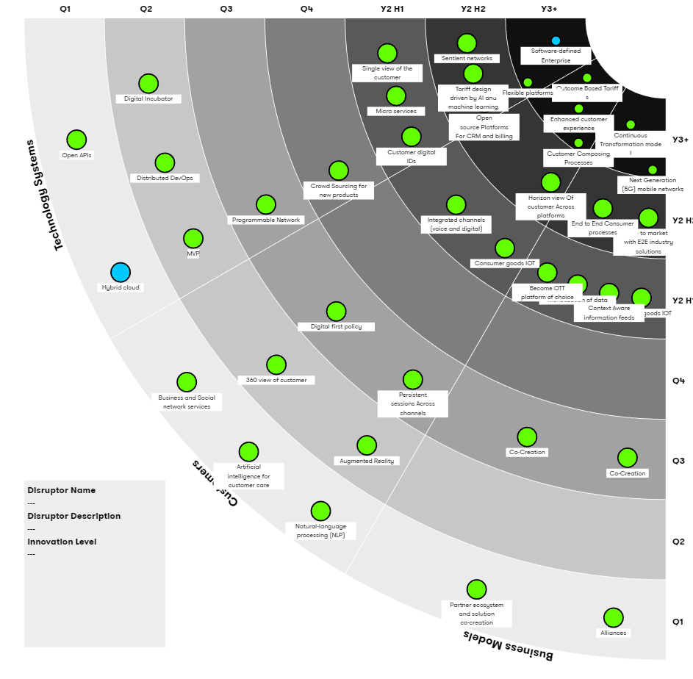
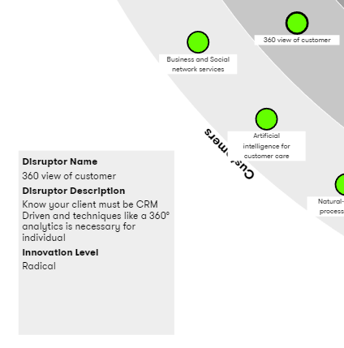
Sunray options
Within the Sunray diagram you have the options to :
Size the disruptors by their innovation levels
Show or hide business or technology disruptors
Only show the focus areas
Highlight any of the disruptor to review the description and other supporting information

Slide 23

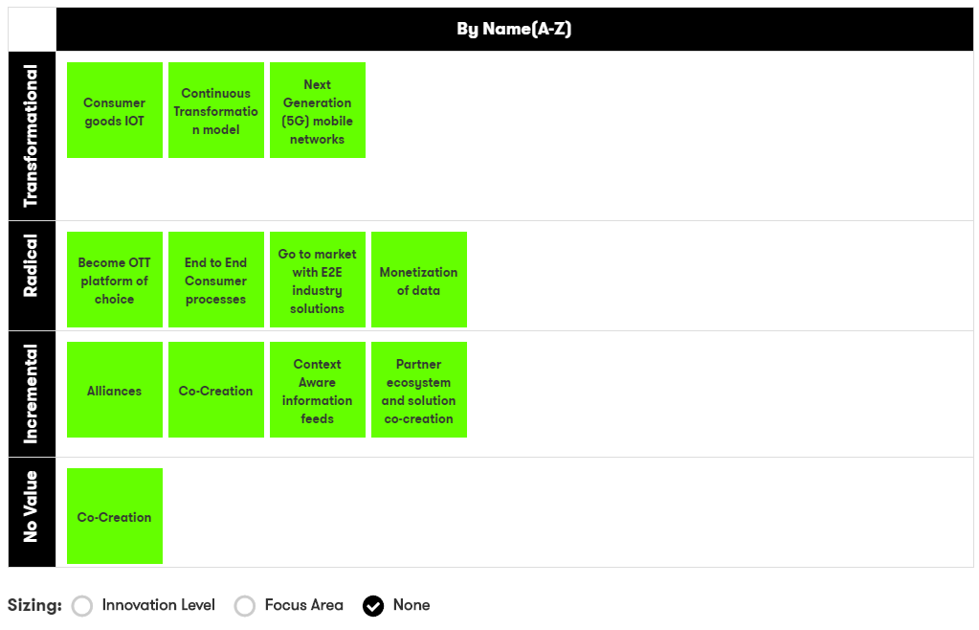
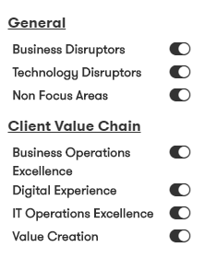
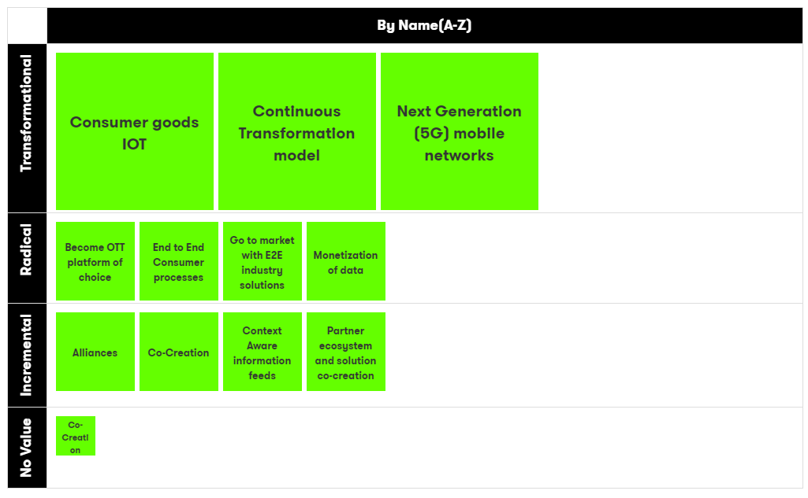
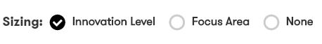
Value Chain Views
Each Value Chain is presented within a dynamic table, the default view groups the disruptors based on their innovation levels and associated business areas.
The horizontal and vertical axis can be altered to provide different views by mixing:
Business Areas
Value Chains
Time
Name (A-Z)
Focus area
Innovation level
Double click to edit the disruptor values

Slide 24
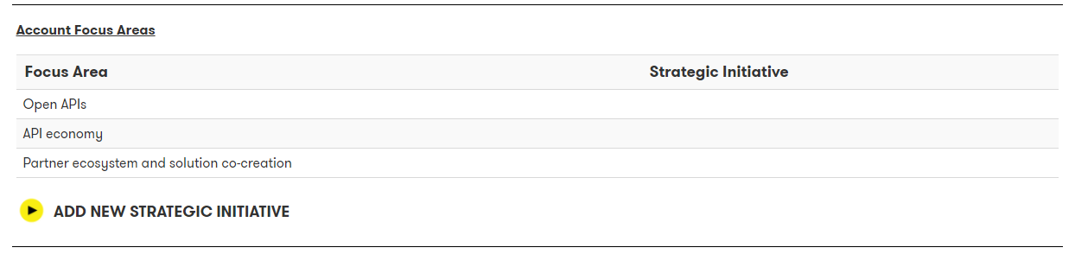
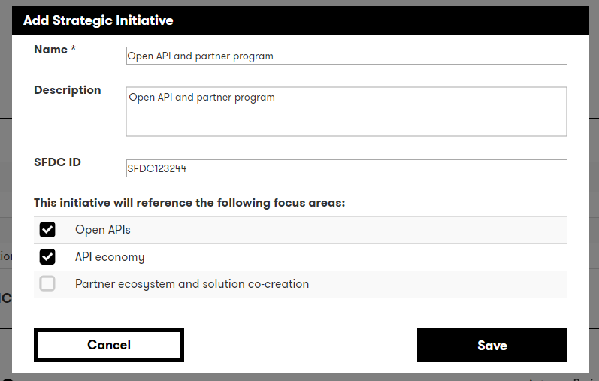
Creating Strategic Initiatives
Once your agenda is saved you are presented with the agenda document, from this view you can select one or more focus areas and define the Client Strategic Initiatives.
A focus area can be mapped to one or more strategic programs.
You can also select to include any client goals or KPI’s
You can update this information by returning to the agenda summary view

Slide 25
Agenda Insights

Slide 26
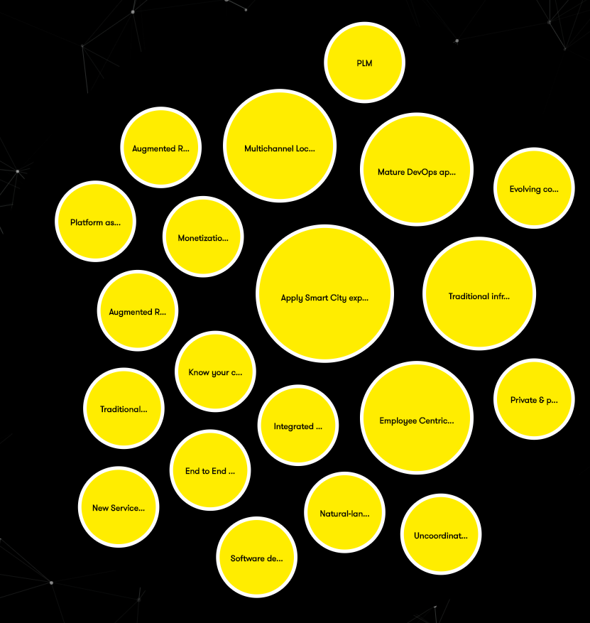

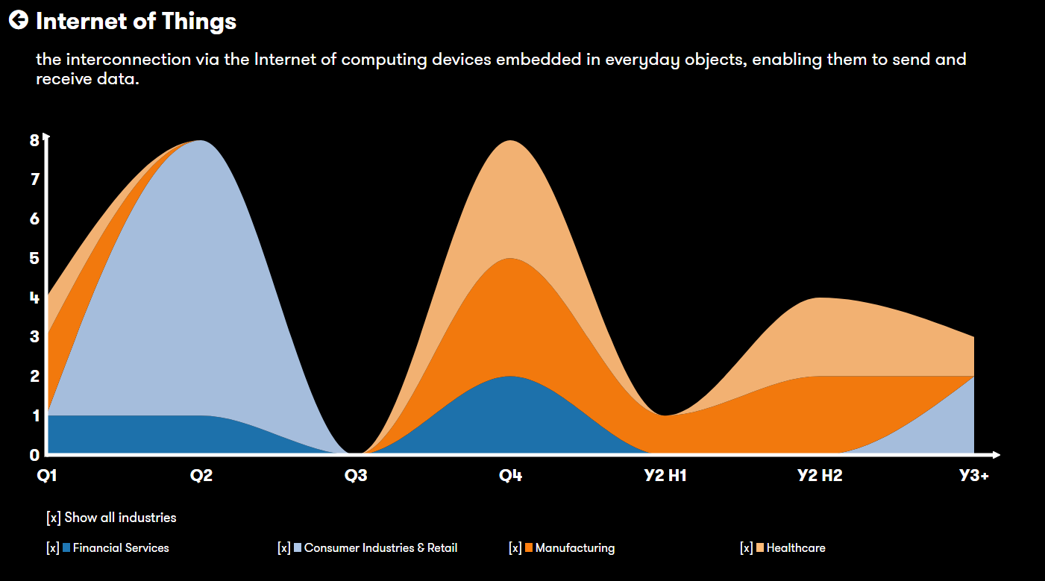
Agenda Insights
Within the Agenda Insights section you can view heatmaps of the most referenced trends within the current valid agenda.
You can group these by region, industry or timing.
You can also view a detailed timeline for any presented trend.

Slide 27
Thank you
For more information please contact David Stevens

